Slide 1
Analyzing the Global Video Games Sales
By
Jun Ying

Slide 2
introduction
Dataset: Global Video Games Sales from 1980 to 2015
Data Frame: 11 columns with 16598 non-null values
Data Source: Kaggle.com
Using Packages: Pandas, Zipfile, plotly, numpy and copy

Slide 3
cleaning and preprocessing
Zipfile and Pandas: Opening and importing the data into python
Add column: vgsales['Number of Games'] = 1
Groupby: Preview the datasets by Year, Platform, Genre and Publisher
List: list_year = [vgsale_2006,vgsale_2007,vgsale_2008,…,vgsale_2015]

Slide 4
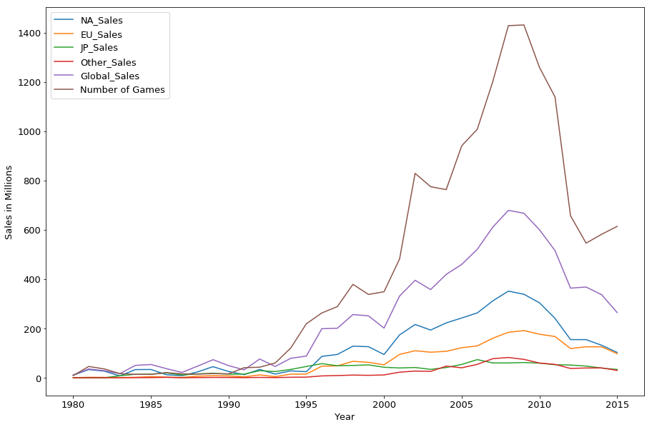
the games sales from 1980 to 2015
year_total = vgsales.groupby('Year').sum()
year_total = year_total.reset_index(drop=False)
year_total['Year'] = year_total['Year'].apply(int)
year_total = year_total.set_index('Year')
year_total.drop([2016,2017,2020], inplace=True)
year_total_line = year_total.plot(figsize=(15,10), fontsize=13)
plt.legend(loc='best', fontsize=13)
year_total_line.set_xlabel('Year', fontsize=13)
year_total_line.set_ylabel('Sales in Millions', fontsize=13)
plt.show()

Slide 5
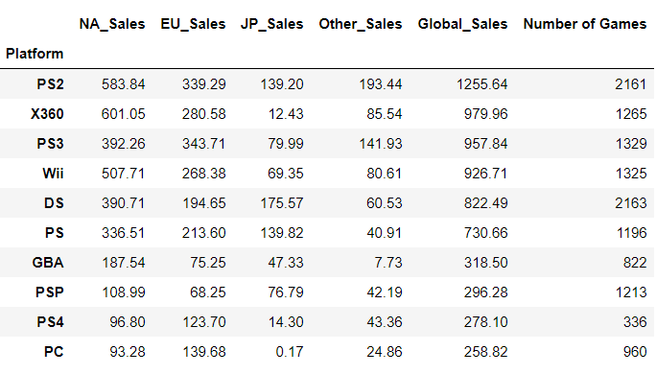
The Global games sales of each Platform from 1980 to 2015
Platform_total = vgsales.groupby('Platform').sum()
del Platform_total['Year'] #ignore the years
Platform_sales_sort = Platform_total.sort_values(by='Global_Sales', ascending=False).head(10)
Platform_sales_sort

Slide 6
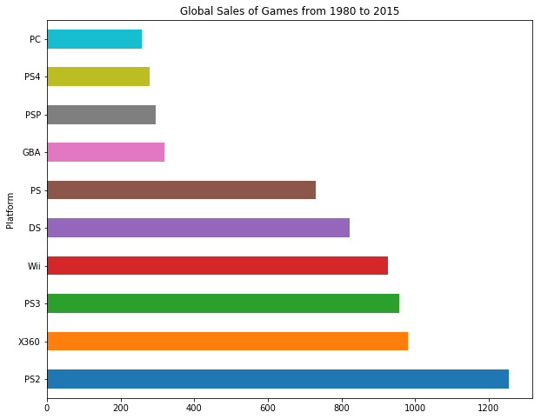
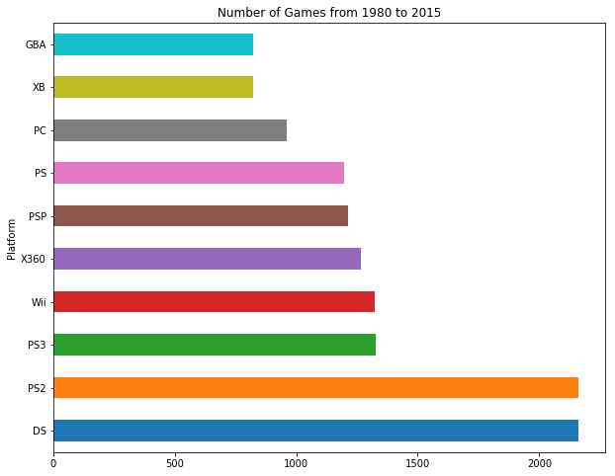
The Global games sales of each Platform from 1980 to 2015

Slide 7
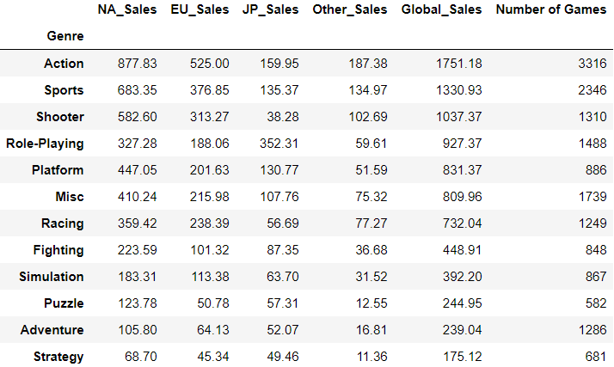
The Global games sales of each Genre from 1980 to 2015
Genre_total = vgsales.groupby('Genre').sum()
del Genre_total['Year'] #ignore the years
Genre_sales_sort = Genre_total.sort_values(by='Global_Sales', ascending=False)
Genre_sales_sort

Slide 8
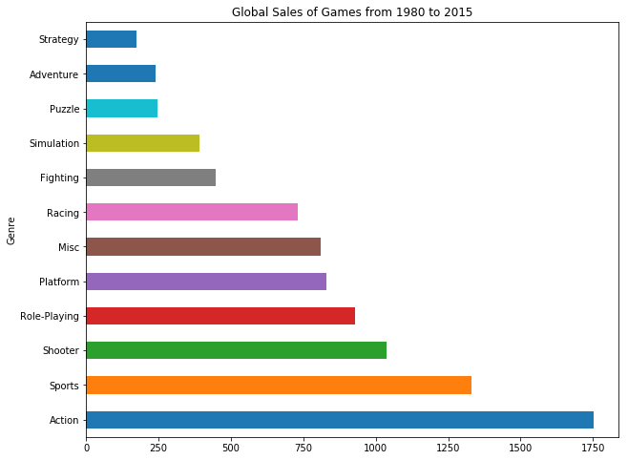
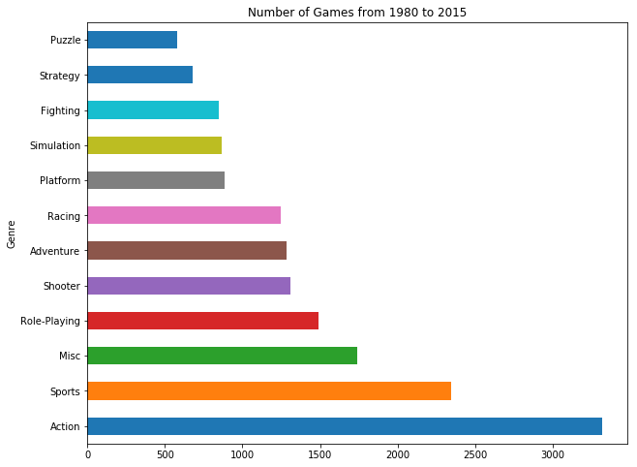
The Global games sales of each Genre from 1980 to 2015

Slide 9
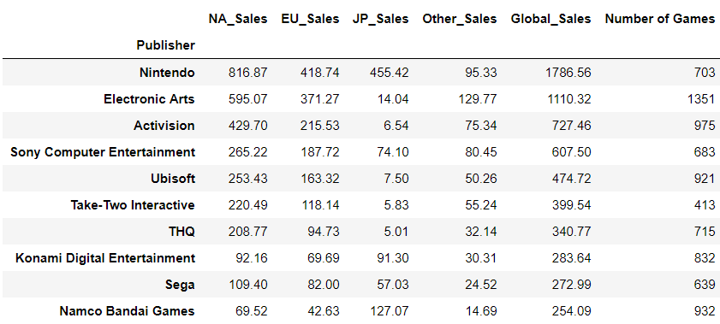
The Global games sales of each Publisher from 1980 to 2015
Publisher_total = vgsales.groupby('Publisher').sum()
del Publisher_total['Year'] #ignore the years
Publisher_sales_sort = Publisher_total.sort_values(by='Global_Sales', ascending=False).head(10)
Publisher_sales_sort

Slide 10
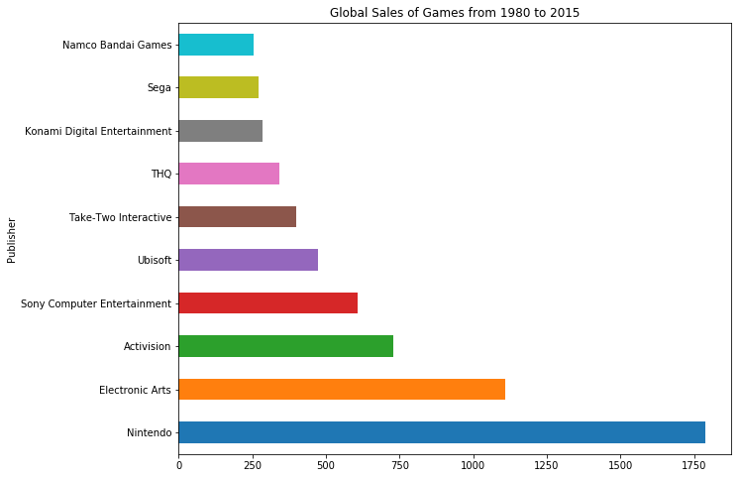
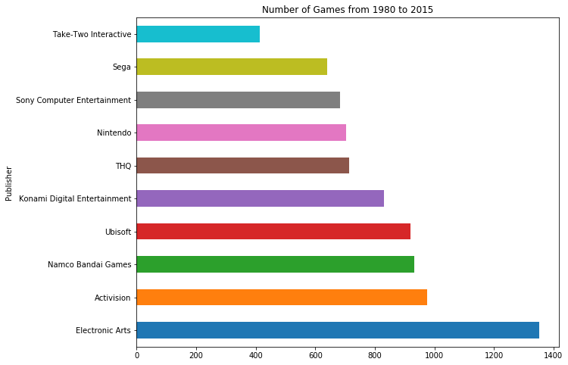
The Global games sales of each Publisher from 1980 to 2015

Slide 11
The Global games sales of each Genre from 2006 to 2015
#select years from 2006 to 2015
sales06_15 = vgsales[vgsales.Year >= 2006]
#draw a bar chart to see the global sales and number of games in these 10 years
Genre_06_15 = sales06_15.groupby('Genre').sum()
del Genre_06_15['Year']
Genre_sales_06_15 = Genre_06_15.sort_values(by='Global_Sales', ascending=False).head(10)
pd.Series(Genre_sales_06_15['Global_Sales']).plot(kind='barh', figsize=(10,8), title='Global Sales of Games from 2006 to 2015')
plt.show()
Genre_games_06_15 = Genre_06_15.sort_values(by='Number of Games', ascending=False).head(10)
pd.Series(Genre_games_06_15['Number of Games']).plot(kind='barh', figsize=(10,8), title='Number of Games from 2006 to 2015')
plt.show()

Slide 12
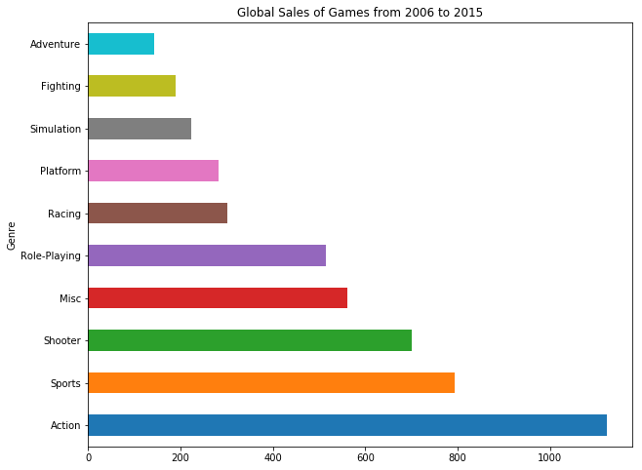
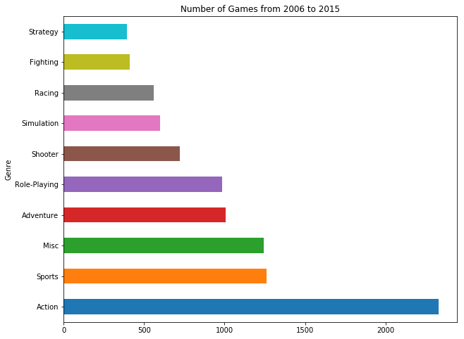
The Global games sales of each Genre from 2006 to 2015

Slide 13
The Global games sales of each Genre from 2006 to 2015
#create data frame of each year
vgsale_2006 = vgsales[vgsales['Year'].isin([2006])]
#turn years into integer
for i in list_year:
i['Year'] = i['Year'].apply(int)
#select each genre from each year
Sports_2006 = vgsale_2006.loc[vgsale_2006['Genre'] == 'Sports’]
#combine the data frame of each genre from each year
Sports = pd.DataFrame()
for a in list_Sports:
i = copy.deepcopy(a)
del i['Year'], i['Name'], i['Platform'], i['Genre'], i['Publisher']
i.loc["sum"] = list(i.apply(lambda x: x.sum())) #sum the whole year sales
Sports = pd.concat([Sports,i],axis=0)
Sports = Sports.loc['sum',:] #select the sums
Sports.index = year06_15 #set index by years

Slide 14
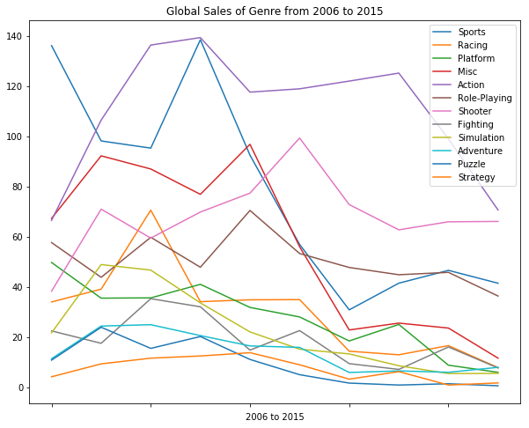
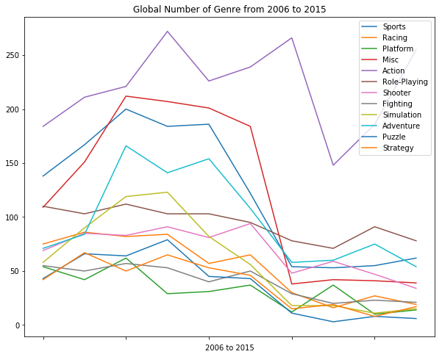
The Global games sales of each Genre from 2006 to 2015

Slide 15
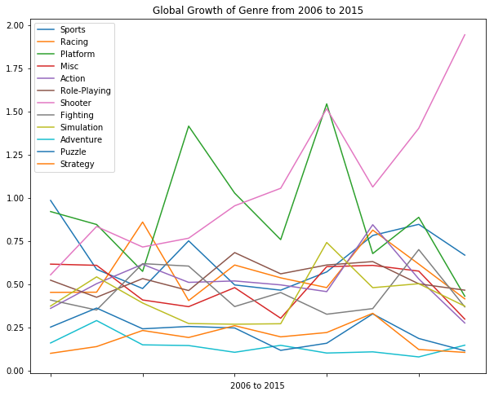
The Global games sales of each Genre from 2006 to 2015
#calculate the Growth
Sports.loc[:,'Global_Sales']/Sports.loc[:,'Number of Games’]
#draw a line chart
Genre_Growth.plot(kind='line', figsize=(10,8), title='Global Growth of Genre from 2006 to 2015')
plt.xlabel('2006 to 2015')
plt.show()

Slide 16
The Global games sales of Shooter from 2006 to 2015
#preview the top 10 Global Sales and number of Publisher from 2006 to 2015
Publisher_06_15 = sales06_15.groupby('Publisher').sum()
del Publisher_06_15['Year']
Publisher_sales_06_15 = Publisher_06_15.sort_values(by='Global_Sales', ascending=False).head(10)
pd.Series(Publisher_sales_06_15['Global_Sales']).plot(kind='barh', figsize=(10,8), title='Global Sales of Games from 2006 to 2015')
plt.show()
Publisher_games_06_15 = Publisher_06_15.sort_values(by='Number of Games', ascending=False).head(10)
pd.Series(Publisher_games_06_15['Number of Games']).plot(kind='barh', figsize=(10,8), title='Number of Games from 2006 to 2015')
plt.show()

Slide 17
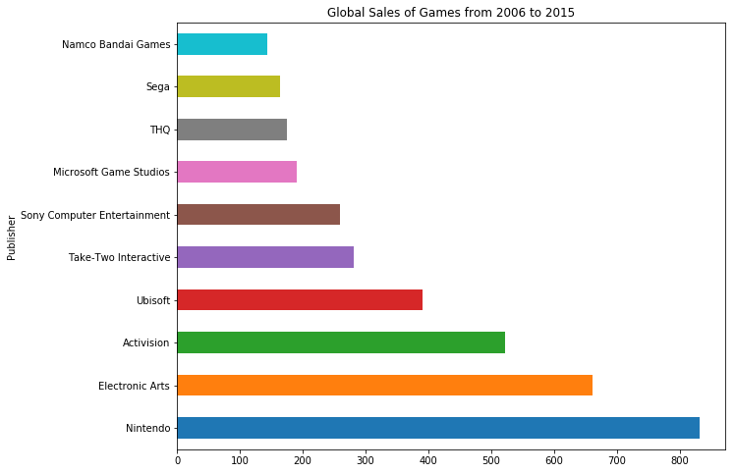
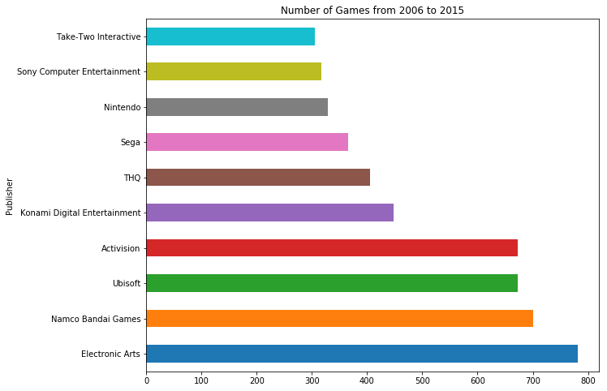
The Global games sales of Shooter from 2006 to 2015

Slide 18
The Global games sales of Shooter from 2006 to 2015
#create data frame of genre: Shooter for top 4 Publisher
#Nintendo, Activision, Electronic Arts and Ubisoft
Shooter_Nintendo = pd.DataFrame()
for a in list_Shooter:
i = copy.deepcopy(a)
i = i.loc[i['Publisher'] == 'Nintendo']
del i['Year'], i['Name'], i['Platform'], i['Genre'], i['Publisher']
i.loc["sum"] = list(i.apply(lambda x: x.sum()))
Shooter_Nintendo = pd.concat([Shooter_Nintendo,i],axis=0)
Shooter_Nintendo = Shooter_Nintendo.loc['sum',:]
Shooter_Nintendo.index = year06_15

Slide 19
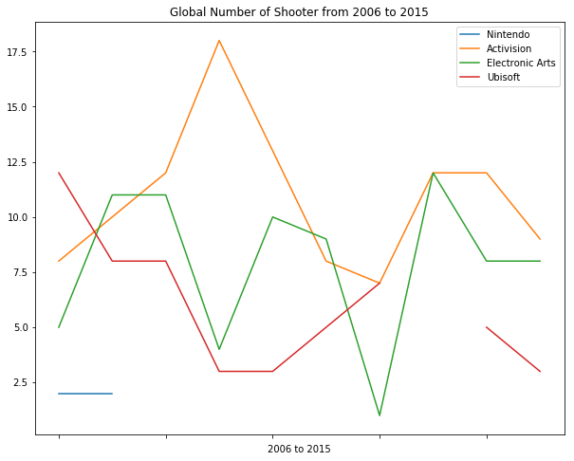
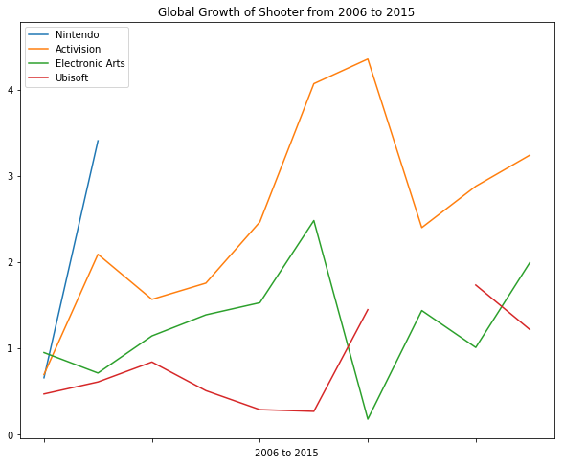
The Global games sales of Shooter from 2006 to 2015

Slide 20
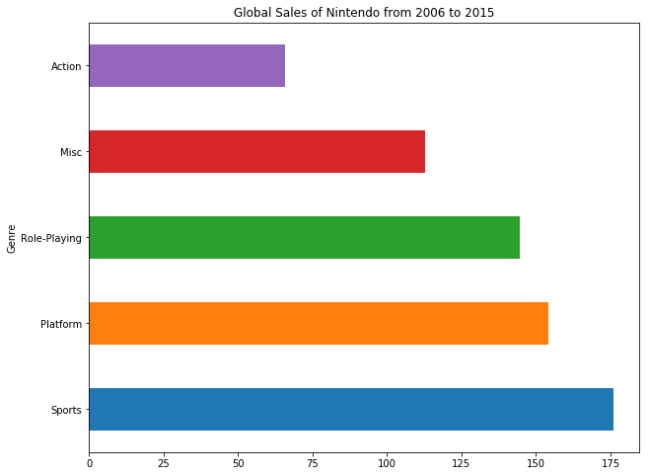
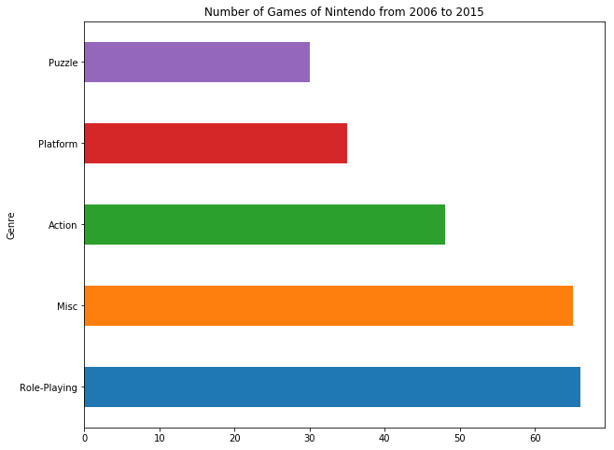
The Global games sales of Top 4 Publisher from 2006 to 2015

Slide 21
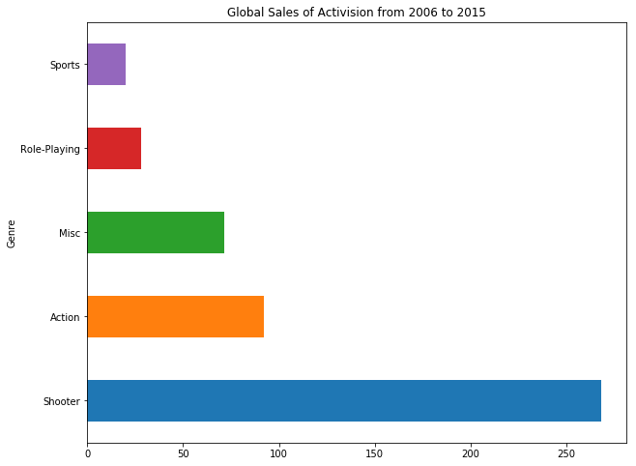
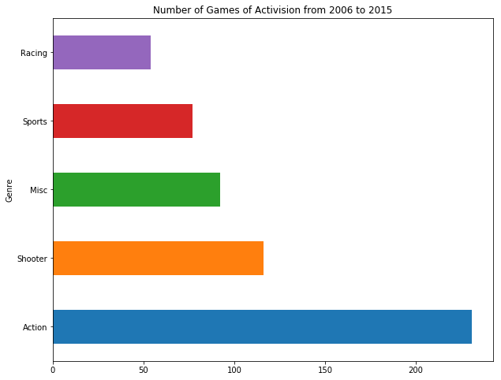
The Global games sales of Top 4 Publisher from 2006 to 2015

Slide 22
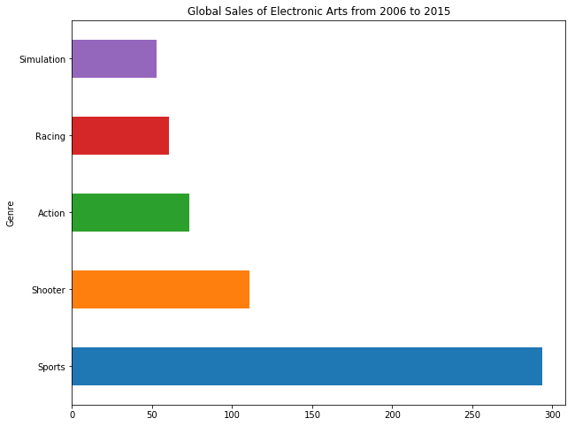

The Global games sales of Top 4 Publisher from 2006 to 2015

Slide 23
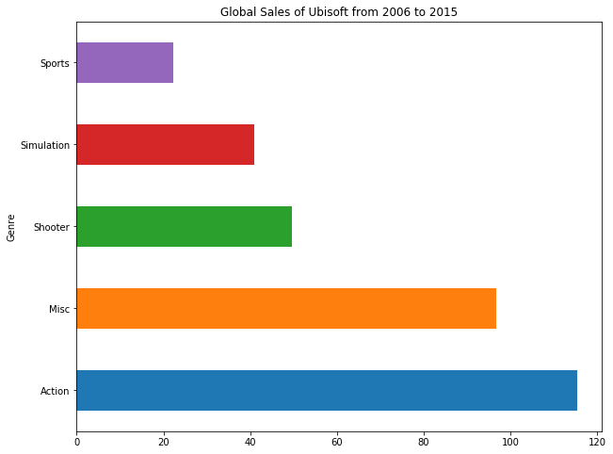
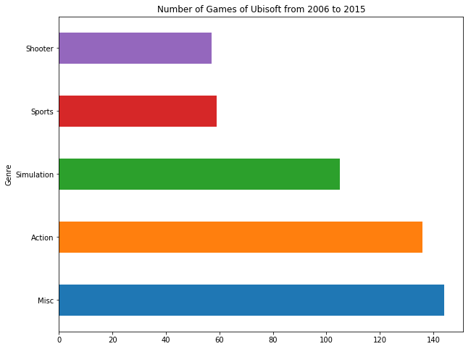
The Global games sales of Top 4 Publisher from 2006 to 2015

Slide 24
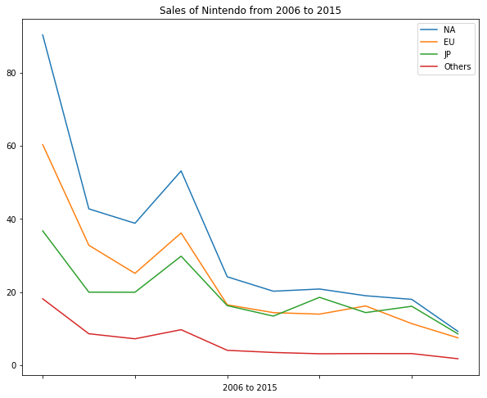
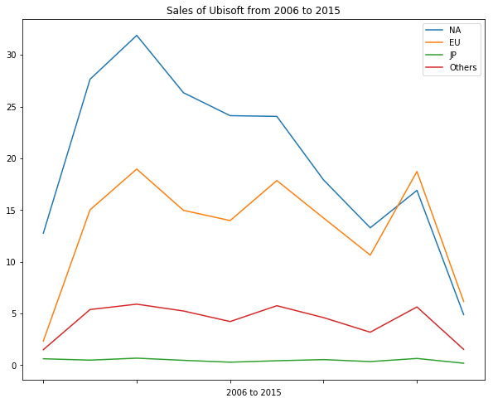
The Global games sales of Top 4 Publisher from 2006 to 2015

Slide 25
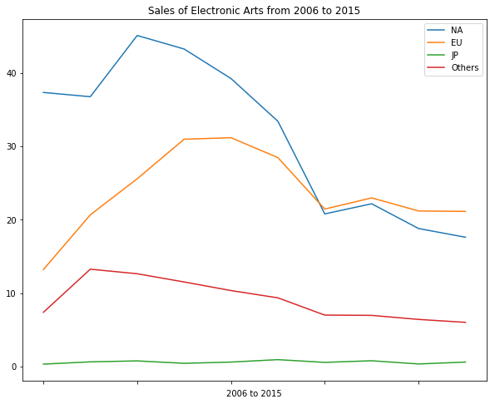
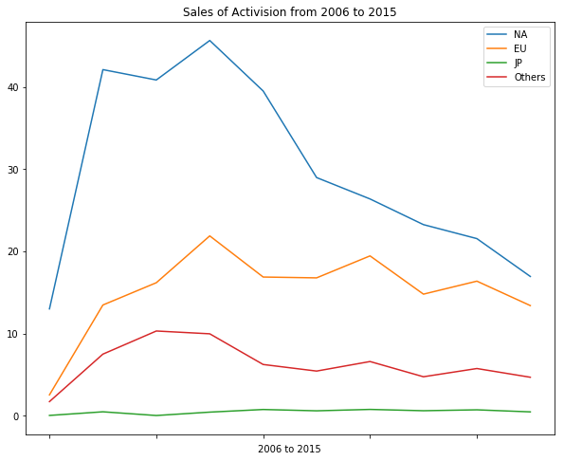
The Global games sales of Top 4 Publisher from 2006 to 2015

Slide 26
The Global games sales of Platform from 2006 to 2015
#group by Platform to find the favorite platform from 2006 to 2015
Platform_06_15 = sales06_15.groupby('Platform').sum()
del Platform_06_15['Year']
Platform_sales_06_15 = Platform_06_15.sort_values(by='Global_Sales', ascending=False).head(10)
pd.Series(Platform_sales_06_15['Global_Sales']).plot(kind='barh', figsize=(10,8), title='Global Sales of Games from 2006 to 2015')
plt.show()
Platform_games_06_15 = Platform_06_15.sort_values(by='Number of Games', ascending=False).head(10)
pd.Series(Platform_games_06_15['Number of Games']).plot(kind='barh', figsize=(10,8), title='Number of Games from 2006 to 2015')
plt.show()

Slide 27
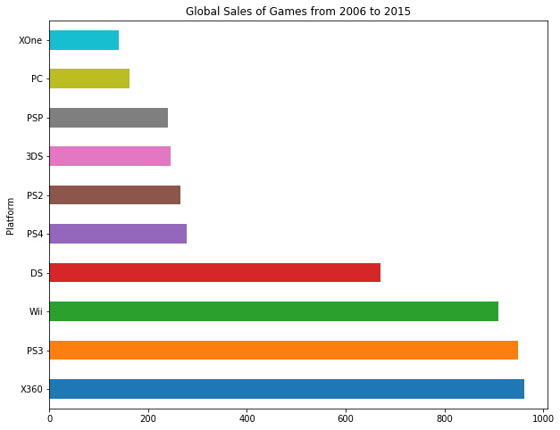
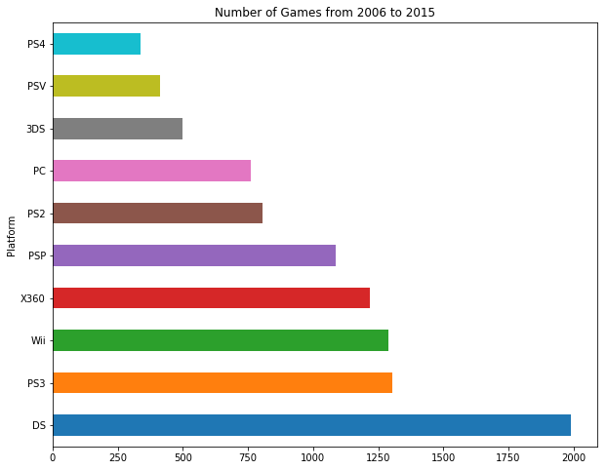
The Global games sales of Platform from 2006 to 2015

Slide 28
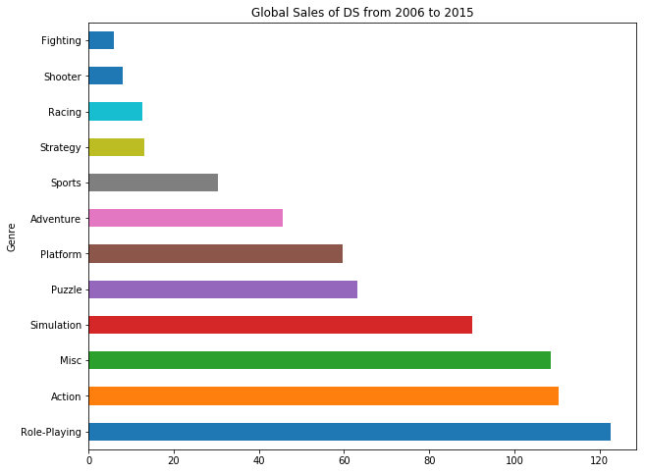
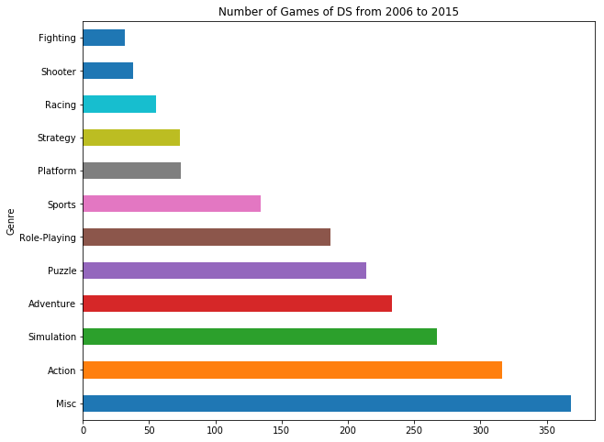
The Global games sales of Platform from 2006 to 2015

Slide 29
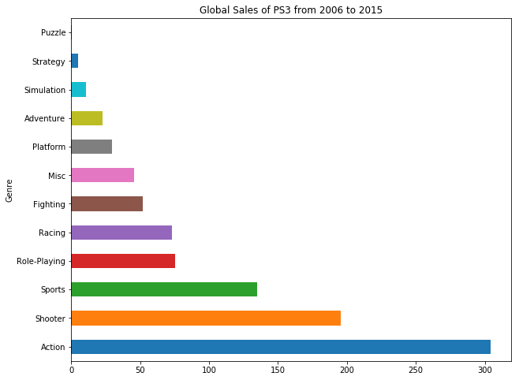
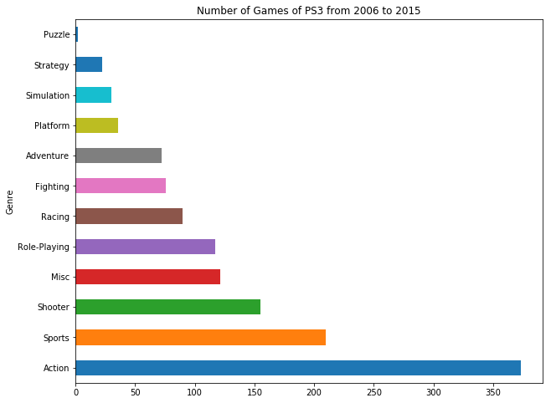
The Global games sales of Platform from 2006 to 2015

Slide 30
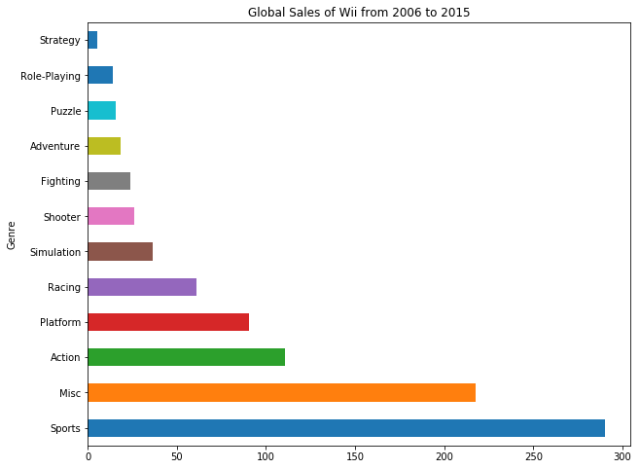
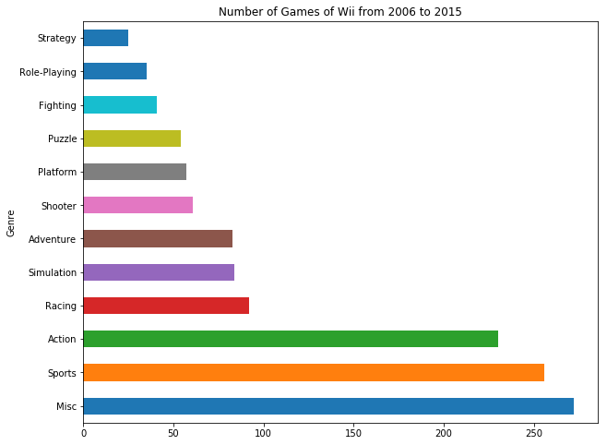
The Global games sales of Platform from 2006 to 2015

Slide 31
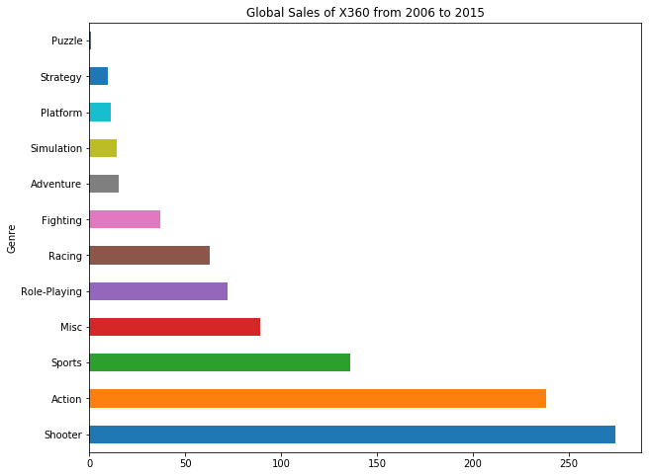
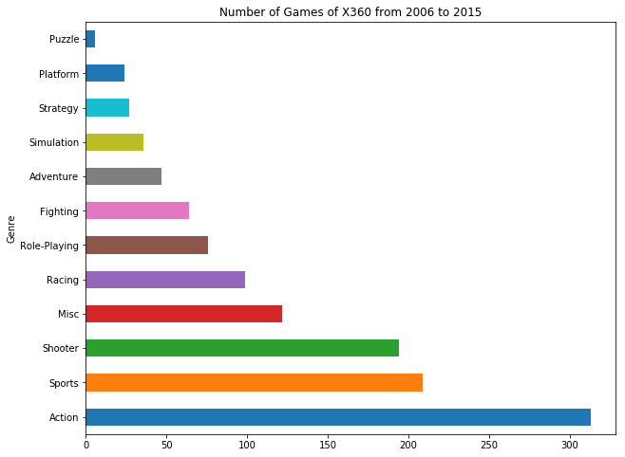
The Global games sales of Platform from 2006 to 2015

Slide 32
predictions
As the global number of games increases, the global sales of games should start to pick up.
With the global sales per game of shooters on the rise, the number of shooters games should increase gradually.
Despite sluggish global game sales, Europe will gradually overtake the United States as the leading region for game consumption.

Slide 33
learning & conclusion
After finishing this project, I learnt how to create dataframes which would be useful for my analyzation and understand what kind of graphic or table is suitable in which situation.
Despite peaking between 2008 and 2011, game sales are on the decline.
For nearly three decades, action games are the most popular games in the world and the most numerous.
Shooting games have become more popular in recent years, but game publisher have not changed their approach to making their own games.
Different regions have different levels of affection for different game publishers, and the most popular genre of games on different platforms also differ.

